Slide 1
Felton Heights Water Tank Replacement Project
November 30, 2022 Felton Library
Notes:
To change the image on this slide, select the picture and delete it. Then click the Pictures icon in the placeholder to insert your own image.

Slide 2
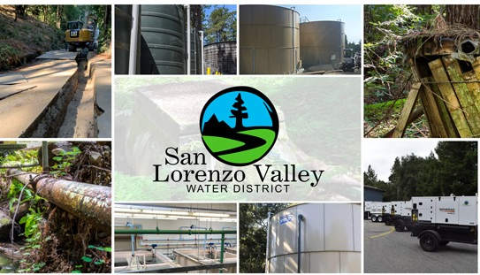
District Representatives
Board of Directors
Gail Mahood: President, Board of Directors
Staff
Rick Rogers: District Manager
Josh Wolff: District Engineer
Carly Blanchard: Environmental Programs Manager

Slide 3
Meeting Overview
Introductions
Staff presentation
History of project
Tank location description
Geotechnical review
Concerns addressed
Environmental review
Next steps
Attendee questions and comments
Closing

Slide 4
Felton Heights Tank History
Felton Heights Mutual Road and Water Association was established to administer a small mutual water system and private roads.
In 2008 SLVWD purchased the Felton Water System from Cal-Am Water.
At the time, the Mutual was receiving water from Cal-Am through a single master water meter.
Felton Heights property owners were part of the Felton LAFCO annexation, and pay the property-associated charges to purchase the Felton Water System.

Slide 5
Felton Heights Tank History - continued
Shortly after the purchase of the Felton Water System, the District entered into discussion with the Mutual to consolidate.
District staff and Mutual representatives developed a proposal that would replace the existing redwood tank with a 60,000 gallon steel tank.
On April 19, 2012, the SLVWD Board of Directors approved the proposed project to assimilate all twenty-one Felton Heights connections into the District.

Slide 6
Felton Heights Tank History - continued
The consolidation agreement made the District responsible for operations, maintenance, and replacement of the existing system.
The tank replacement project was estimated to cost $162,500.
The proposed fair-share cost (in lieu of connection fees) for each of the 21 connections was $3,095, to be collected over 10 years and included accrued 3% interest.
Collection was to begin once construction started. To date, the District has not collected any funds for tank replacement.

Slide 7
Existing Tank Site: Valhalla Way
The existing Valhalla tank site is tiny: approximately 30’ x 30’.
The originally proposed 62,000-gallon tank measures 25’ wide by 16’ tall.
The existing tank site was too small to accommodate the new tank, fencing, piping, and proper access.
The District negotiated an additional 10’ x 30’ easement to expand the tank site to 40’ x 30’.
After recording the additional easement, the property owner expressed concerns about the proximity of the tank to their home.

Slide 8
Proposed Tank Site: End of Lost Acre Drive
On May 4, 2013, Shingle Mill Road resident, Jon Erickson, contacted the District offering his property at the end of Lost Acre Drive as a potential tank location.
In addition to providing additional property, the Lost Acre site allowed the District to consider constructing a 120,000-gallon tank, thereby meeting the required fire flow for the neighborhood.
This location also would allow the District to supply water to another small system with a separately-maintained source at Bennett Spring.
Notes:
After hearing neighborhood concerns constructing the tank at the end of Valhalla Way. On May 4, 2013 Jon Erickson contacted the District offering to consider moving the tank to his property at the end of Lost Acre Drive.
The site that was offered was a perfect fit. It not only provided additional property the District could construct the 120,000-gallon fire flow required tank
We looked at two sites with Jon in the same area that would work basically on either side of the Dirt 40 foot easement access road.
Of the two areas look at Jon selected the corner site as it would located the tank out of the way.

Slide 9
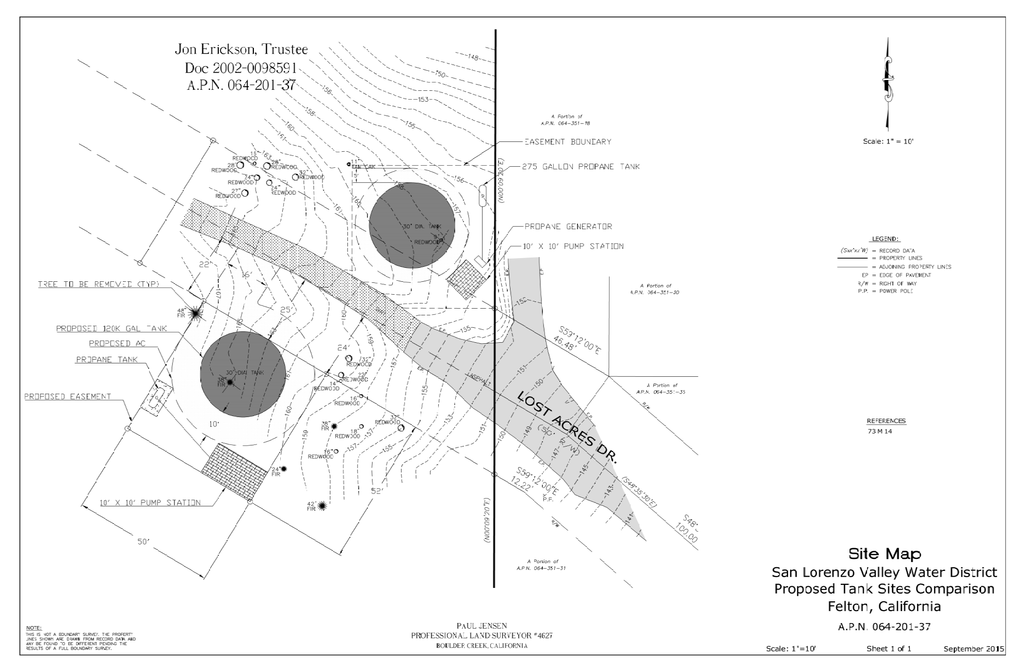
Proposed Tank Sites: End of Lost Acre Drive
N
Initially, two sites, N and S of the easement access road, were considered.
Both have room for a LPG tank, generator, and small pump station. Noise control will be included in the pump station design.
S

Slide 10
Proposed Tank Sites: End of Lost Acre Drive
N
Of the two sites, District staff thought the S one was better.
Jon Erickson, however, preferred the N site, so that was the one that the District investigated, starting with a geotechnical study.
S

Slide 11
Geotechnical Investigation
A geotechnical investigation of the north Lost Acre tank site evaluated the soil and bedrock conditions and developed geotechnical design criteria.
Reports by geotechnical consultants Haro, Kasunich and Associates (June 2016, November 2022) indicated that the construction of a 120,000-gallon water tank at the site is acceptable from a geotechnical standpoint.
The full report can be found at the District’s website: https://www.slvwd.com/projects/pages/felton-heights-tank-replacement-project
Notes:
The purpose of our geotechnicial investigation was to evaluate the soil and bedrock conditions at the referenced alternate tank site and develop geotechnical design criteria and recommendations for proposed replacement water tank foundations and associated improvements. It is presumed the most current California Building Code (CBC) edition design considerations, specifically the seismic factors and coefficients from Chapter 16, Volume II, will be followed during design and construction of the projects.
If the tank location is changed a new investigation will be required/completed.
Based on the results of the Haro, Kasunich and Associates, Nov 2022/June 2016 reports, investigation, of the proposed construction of a replacement 120,000-gallon water tank on the Lost Acres Alternate Tank Site is acceptable from a geotechnical standpoint, provided the following geotechnical criteria and recommendations are incorporated into the design and construction of the project.

Slide 12
Proposed Tank Sites: End of Lost Acre Drive
Subsequent to the Nov. 3, 2022, Board meeting, District staff revisited the S Lost Acre site, renewing their preference for it.
A line of redwood trees blocks views of the tank from the road and homes.
N
S

Slide 13
Proposed Tank Sites: End of Lost Acre Drive
If the S tank site is chosen, a new geotechnical investi-gation will be required.
Project completion is about 18 months for either site (and for Valhalla) because of environmental review and supply chain delays.
N
S

Slide 14
Anticipating some potential questions from neighbors . . .
Notes:
After hearing neighborhood concerns constructing the tank at the end of Valhalla Way. On May 4, 2013 Jon Erickson contacted the District offering to consider moving the tank to his property at the end of Lost Acre Drive.
The site that was offered was a perfect fit. It not only provided additional property the District could construct the 120,000-gallon fire flow required tank
We looked at two sites with Jon in the same area that would work basically on either side of the Dirt 40 foot easement access road.
Of the two areas look at Jon selected the corner site as it would located the tank out of the way.

Slide 15
Would a new tank at the end of Lost Acre Drive impact the 40-foot easement crossing Erickson property?
It will not.
The tank will not be constructed on the easement or its right-of-way.

Slide 16
How will the road be repaired after the tank installation?
A videotape of the roadway to be used by the District and its contractors will be taken before construction starts to establish the “before” state.
Once construction is done, the District will repair the road, returning it to the “before” state.
The District will walk the road repairs with Felton Height representatives to establish satisfaction with the repairs.
Because the tank comes in pieces that are bolted together, there are no large vehicles required for construction (e.g., nothing larger than a cement truck).

Slide 17
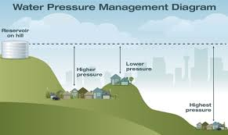
Why can’t the tank be located on the District’s property above the Erickson property? It’s too high.
Water pressure is proportional to height of storage; the higher the tank above homes, the greater the pressure in the delivery system.
The elevation of the Valhalla and Lost Acre sites are identical.
Every 1-foot increase in elevation increases system pressure by 0.43 psi.
Example: Storage only 30’ higher = pressure increase of 13 psi.
In older water distribution systems, changes of only a few psi create leaks and property damage.

Slide 18
Why put in a 120,000 gallon tank?
Existing potable water demand in Felton Heights requires 27,000 gallons of storage per day.
The Bennett Spring zone would require 33,000 gallons per day.
Storage required to meet California Fire Code fire-flow minimum is 60,000 gallons (enough water to put out one house fire).
Total = 120,000 gallons, which is also the current District standard.
Notes:
While we refer to fire flow, what we are really talking about is the storage required to provide the specified flow rate for a specified time, thus "Fire Flow and Storage"Project
Note that the 60K requirement is 1,000-gpm for 60-minutes

Slide 19
Why is the tank supplying the Bennett Spring zone?
When Felton Heights consolidated into the District they became part of our larger water district. When the District upgrades facilities, it is required to review overall operations to improve water reliability, water quality and operating costs.
Tying the Bennett Spring zone into a tank at Lost Acre Drive will achieve all of the above, which helps keep operating costs under control for all District customers.
The new tank will not be supplying water to Bennet Spring zone homeowners directly; it will only be used to supply water to fill the Bennett Spring tank.
The new tank would

Slide 20
Separate project: pipeline to Bennett Spring
The Bennett Spring pipeline is not part of the current tank replacement project.
A pipeline will be installed underground along the fire access road to the existing 5,000-gallon Bennett Springs storage tank.
Will require separate geotechnical and environmental reviews.
Completion around 2026-2027.
Notes:
Explained what is CEQA

Slide 21
Next Steps
Select a proposed location for the new tank.
Perform new geotechnical investigation, if moved from previously proposed N Lost Acre site to the S site.
Work with the property owner(s) to develop a plan for acquisition of the tank site and water line easements to Bennett Spring.
Inform the neighborhood of the proposed tank location.
Perform environmental review.
Board of Directors approval of project.
Construct a new 120,000-gallon steel tank.

Slide 22
Initial Steps in Environmental Review
Review available design documents and studies that cover the project area.
Identify jurisdiction of regional, state, and/or federal regulatory agencies.
(County does not have jurisdiction for this type of project.)
Review final design and determine permitting needs and level of environmental analysis under CEQA (California Environmental Quality Act).
Notes:
Identify jurisdiction of the US Army Corps of Engineers, California Department of Fish and Wildlife, and the Regional Water Quality Control Board, and other relevant agencies.
Note that the County does not have jurisdiction for this type of project to head off concerns about permitting?

Slide 23
California Environmental Quality Act (CEQA) Review Process
Coordinate and consult with the appropriate regulatory agencies.
Conduct cultural and biological resources surveys as needed.
Draft CEQA document.
Solicit public comment regarding project.
Conduct public meeting to discuss findings.
Board of Directors review and approval of CEQA document.

Slide 24
Next Steps -- continued
Select a proposed location for the new tank.
Perform new geotechnical investigation, if moved from previously proposed (N) Lost Acre site to the S site.
Work with the property owner(s) to develop a plan for acquisition of the tank site and water line easements to Bennett Spring.
Inform the neighborhood of the proposed tank location.
Perform environmental review.
Board of Directors approval of project.
Construct new 120,000-gallon steel tank.

Slide 25
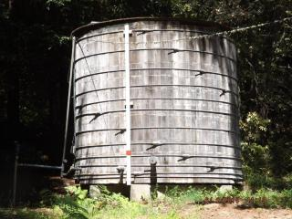
Felton Heights Tank Project
Questions, comments, or concerns?

