Slide 1
Utility Rates 101

Slide 2
Raftelis Team
Melissa Elliott Project Director
Theresa Jurotich Project Manager
Lindsay Roth Lead Consultant
Legal process for setting utility rates

Slide 3
Key Focus Areas
How Utilities are Funded
Utility Rate Studies
Cost of Service Analysis & Rate Design
Rate Approval Process
Pricing Objectives

Slide 4
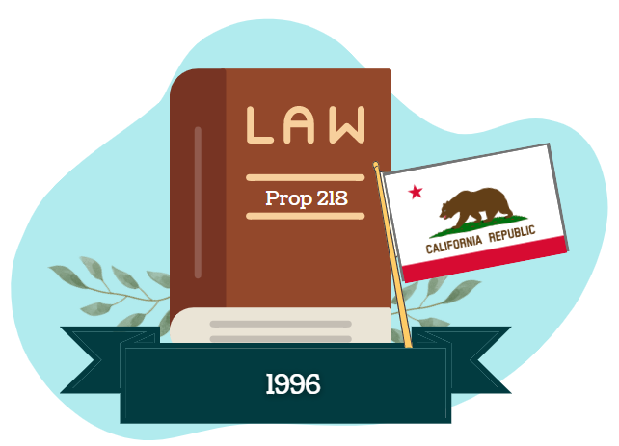
Funding a Utility Enterprise
Rates must keep up with costs to operate the Enterprise.
Funded by customer rate revenue, Enterprise utilities DO NOT earn profits.
Utility Bill
CA law (Proposition 218) requires that rates must be based on the cost to provide the Enterprise’s service.
Legal process for setting utility rates

Slide 5
Rates and Fees Must:
Fund Operations
Fund Capital Projects
Maintain Reserves
Ensure Customer Rate Equity

Slide 6
How We’ll Get There
Fund Operations
Financial Plan
Fund Capital Projects
Cost-of-Service
Maintain Reserves
Ensure Customer Rate Equity
Rate Design

Slide 7
What is a Rate Study?
A financial planning process to set rates that considers:
Fairness & Equity
Utility Financial
Viability
Operations & Maintenance
Community
Values
Infrastructure
Investment
Legal Defensibility
Notes:
Ensure rates customers pay are: (Click)
Fair and equitable (Click)
Align with community values and priorities (Click)
Sufficient to ensure the utilities’ continued financial viability
Your water utility is owned by you, the customer. They can not charge more than the cost of providing the service; this is not a profit center for the City’s general fund, and there are no shareholders looking for dividends. (Click)
Sufficient to enable efficient operations and critical routine maintenance (Click)
Sufficient to enable critical infrastructure investment to aid appropriate levels of service and comply with ever more stringent regulatory requirements (Click)
Aligned with industry best practices and compliance with state law. (Click)

Slide 8
Steps in Conducting a Rate Study
Start
Completion
1.
Rate Setting Framework
3.
COS & Rate Design
5.
Financial goals and policies
Pricing objectives
Alternative rate structures for evaluation
Cost of Service Analyses (Cost allocations)
Alternative rates design
Rate calculations & customer impact analyses
Rate Adoption- 218 Procedures
Notice to customers
Public Hearing
2.
Evaluate operating and capital costs
Cash flow analysis for revenue sufficiency
CIP Financing Options
Scenario Analysis
4.
Financial Plan
Documentation
Study Report
Review by legal counsel
Rate Adoption

Slide 9
Financial Plan
District Employee Salaries & Benefits
Debt Service & Other Non-operating
Purchased Water
Operations & Maintenance
Capital Projects
Funding Gap
Funding Gap
Reserves

Slide 10
What is Cost of Service?
Revenue Requirements
Cost of Service by Customer Class
Method to recover costs:
Between fixed charges and variable rates
From customers in proportion to their use of the system, recognizing the impact of each class on system facilities and operations.
Best Practices and industry guidance used throughout the U.S. to set utility water and wastewater rates:
Water: American Water Works Assn. (AWWA) Manual of “Principles of Water Rates, Fees and Charges”
Wastewater: Water Education Foundation (WEF) Manual “Financing and Charges for Wastewater Systems”

Slide 11
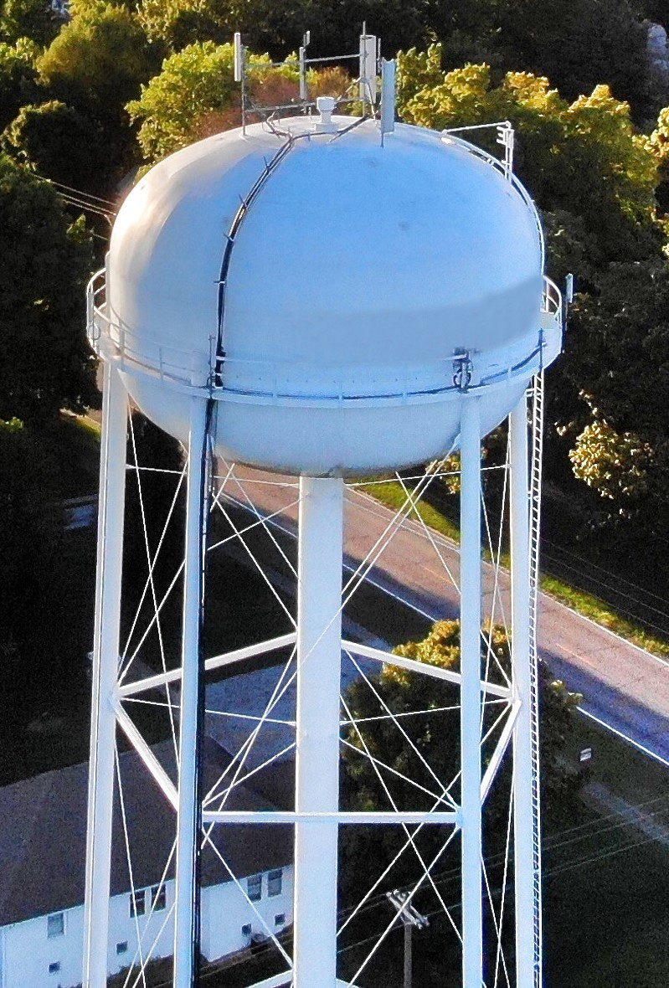
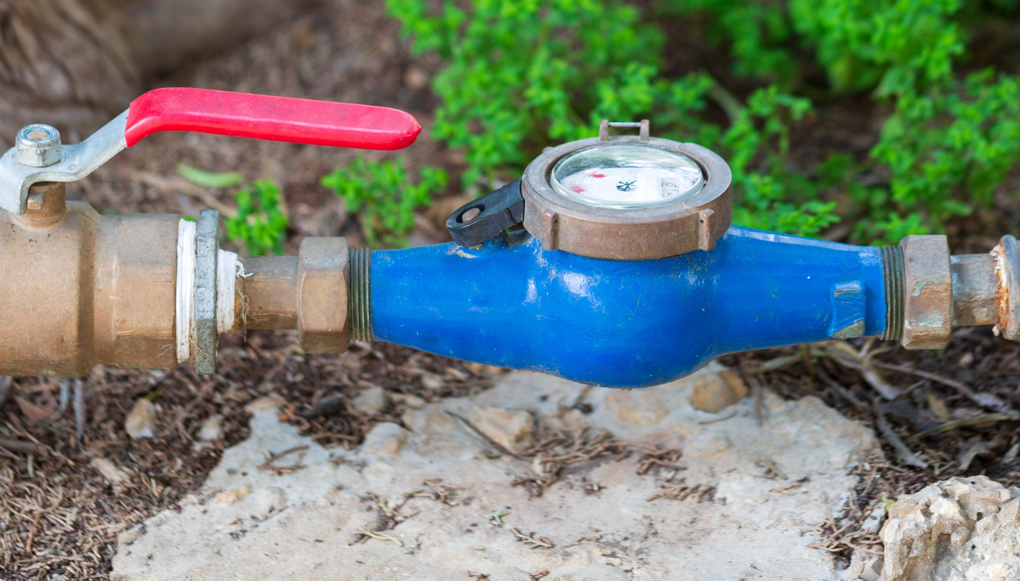
Fixed Cost Recovery – Types of Costs Included
Fixed Cost Recovery – Types of Costs Included
Customer service
Billing & collection
Processing and mailing bills
Meter shop /maintenance/repair
Meter reading
System Capacity
11

Slide 12
Volumetric Rate Design Derivation
Costs allocated to volumetric cost recovery are used to derive the volumetric rate
Single uniform rate for everyone
Uniform rates by customer class
A mix of tiered rates for one class and uniform rates for other customer classes
If using tiered rates: must be based on the cost to serve water to customers in that tier
The total tiered rates and customer class rates can be broken down into different components:
Supply, delivery, peaking, etc.
Tier breaks can be based on:
Water supply sources, peaking, efficiency targets, etc.

Slide 13
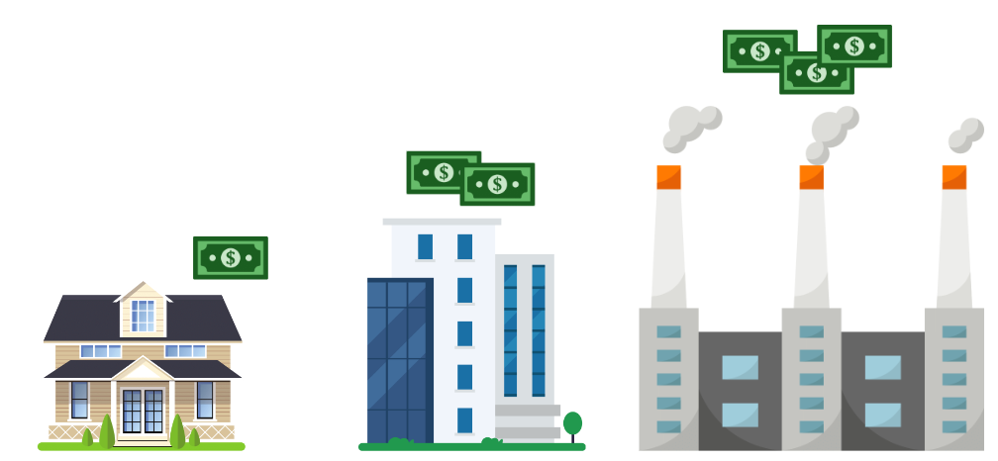
Cost of Service and Customer Class Rates
Rationale:
Different types of customers generate different costs because of their use characteristics.
Cost of service allows the matching of the rates charged to each group with the cost incurred to serve them.
Each group will “pay its own way” - no subsidies.
Notes:
Different types of customers generate different costs because of their use characteristics. Each customer group must pay their fair share and can’t be required to pay the costs incurred by another group. For example, residential customers can’t be required to pay more so commercial customers can pay less, or vice-versa.

Slide 14
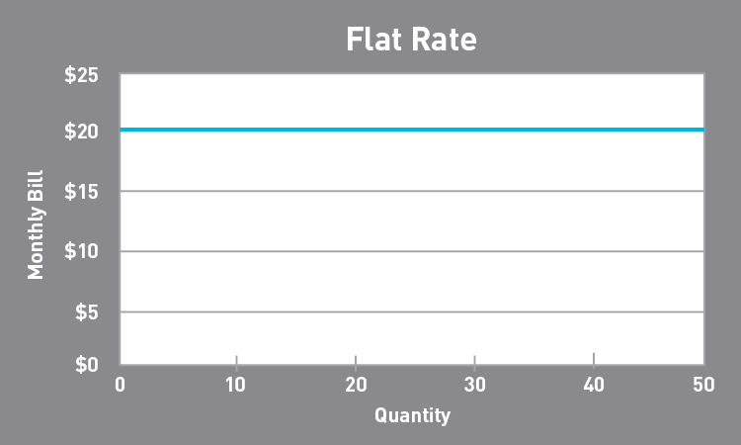
Water Rate Structure Evolution
Revenue Mechanism
Flat Rate
Flat Rate: $xx / month regardless of usage
Pros: Revenue stability; easy to understand
Cons: Inequitable; no conservation signal; not affordable for essential use
14

Slide 15
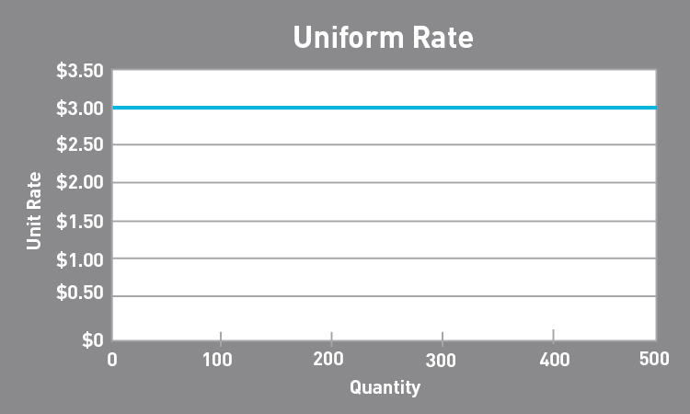
Water Rate Structure Evolution
Revenue Mechanism
Flat Rate
Price Information
Uniform Rate
Uniform Rate: $xx / ccf
Pros: Revenue stability; administrative ease; easy to understand
Cons: Weak conservation signal; not affordable for essential use
15

Slide 16
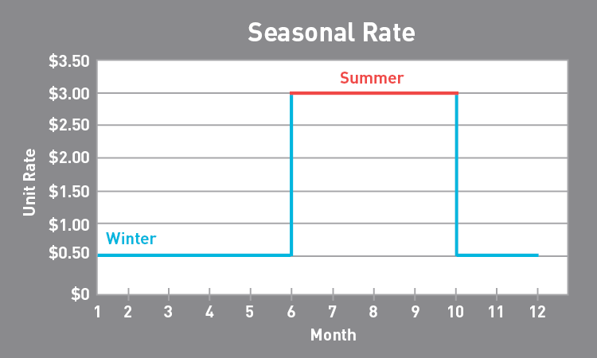
Water Rate Structure Evolution
Revenue Mechanism
Flat Rate
Price Information
Uniform Rate
Seasonal Rate
Behavior Change
Seasonal Rate: $ xxx / ccf in Summer, $ x/hcf in Winter
Pros: Promote water conservation in the summer; easy to administer
Cons: Revenue instability; not affordable for essential use
16

Slide 17
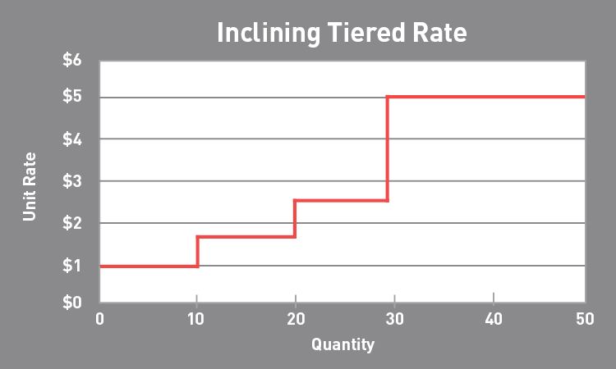
Water Rate Structure Evolution
Revenue Mechanism
Flat Rate
Price Information
Uniform Rate
Seasonal Rate
Behavior Change
Inclining Tiered Rate
Inclining Tiered Rate:
Pros: Promotes conservation; affordable for essential use; easy to administer; easy to understand
Cons: Targets large users, may generate revenue instability
17

Slide 18
Pricing Objectives

Slide 19
Pricing Objectives
Revenue Stability
Affordability
Financial Sustainability
Conservation
Administrative Ease
Equity
Defensibility
Customer Understanding

Slide 20
Pricing Objectives Priorities for SLVWD
Revenue Stability
Affordability
Financial Sustainability
Conservation
Administrative Ease
Equity
Defensibility
Customer Understanding
Notes:
In discussions to date, 3 bubbling to the top.
Defensible & financial sustainability are givens.

Slide 21
2022 California Residential Water Rate Structure Survey
325 CA entities surveyed
57.8% fixed charge + tiered rate
34.8% fixed charge + uniform rate
6.5% fixed charge + individualized (budget) rate
0.6% fixed charge + seasonal tiered rate
0.3% seasonal tiered only
Notes:
Only talk about the top 2

Slide 22
Anticipated Schedule
Activity | Date
Kickoff | May 30, 2023
Staff Webinars | June – Sept 2023
Board Presentation | July 13, 2023
Board – Present Financial Plan(s) | Aug. – Sept. 2023
District’s Public Outreach Workshop | Sept. or Oct. 2023
Board – Rate Authorization | Oct. 19, 2023
Prop 218 Notice Mailed | Dec. 1, 2023
Final Report | Dec. 20, 2023
Public Hearing | Jan. 18, 2024
Rates Effective | Feb. 1, 2024

Slide 23
Scope & Deliverables
Scope
Pricing objectives workshop (this meeting)
Water & wastewater financial plan, cost-of-service analysis, and rate study
Recommended water and wastewater rates for 5-yr period (FY2024 – FY2028)
Two options for alternative water rate structures
Deliverables
Final report documenting rate study
Final rate model in Microsoft Excel

Slide 24
Thank you!
www.Raftelis.com
24
Notes:
(Use this last slide when Rates 101 is a stand-alone. Otherwise, when included in a broader PPT, end with slide #21).
Thank you for joining us on this quick tour of setting legal utility rates in California.

